Slide 1
Transforming Your Relationship With Money
Basic skills to get you moving in the right direction.

Slide 2
Financial self-care means taking the time to focus on your finances and create healthier money habits that lead to greater financial health and overall wellbeing.

Slide 3
4 STEPS FOR ACHIEVING GREATER FINANCIAL HEALTH
EXPLORE YOUR FINANCIAL VALUES
REVIEW YOUR CURRENT FINANCIAL SITUATION AND SPENDING HABITS
FOCUS ON SPENDING THAT HELPS YOU MEET YOUR GOALS
CREATE A SPENDING PLAN

Slide 4
STEP 1 – EXPLORE YOUR FINANCIAL VALUES
SPEND SOME TIME EVALUATING HOW YOU FEEL ABOUT MONEY
WHAT ARE THE FIRST 3 WORDS THAT COME TO MIND WHEN YOU THINK OF THE WORD “MONEY”

Slide 5
STEP 2 – REVIEW YOUR CURRENT FINANCIAL SITUATION & SPENDING HABITS
WRITE DOWN ALL YOUR INCOME, EXPENSES, DEBTS & SAVINGS
HAVING A FULL VIEW OF YOUR FINANCIAL PICTURE CAN HELP YOU SEE AREAS OF IMPORVING & MAKE A PLAN FOR MOVING FORWARD.

Slide 6
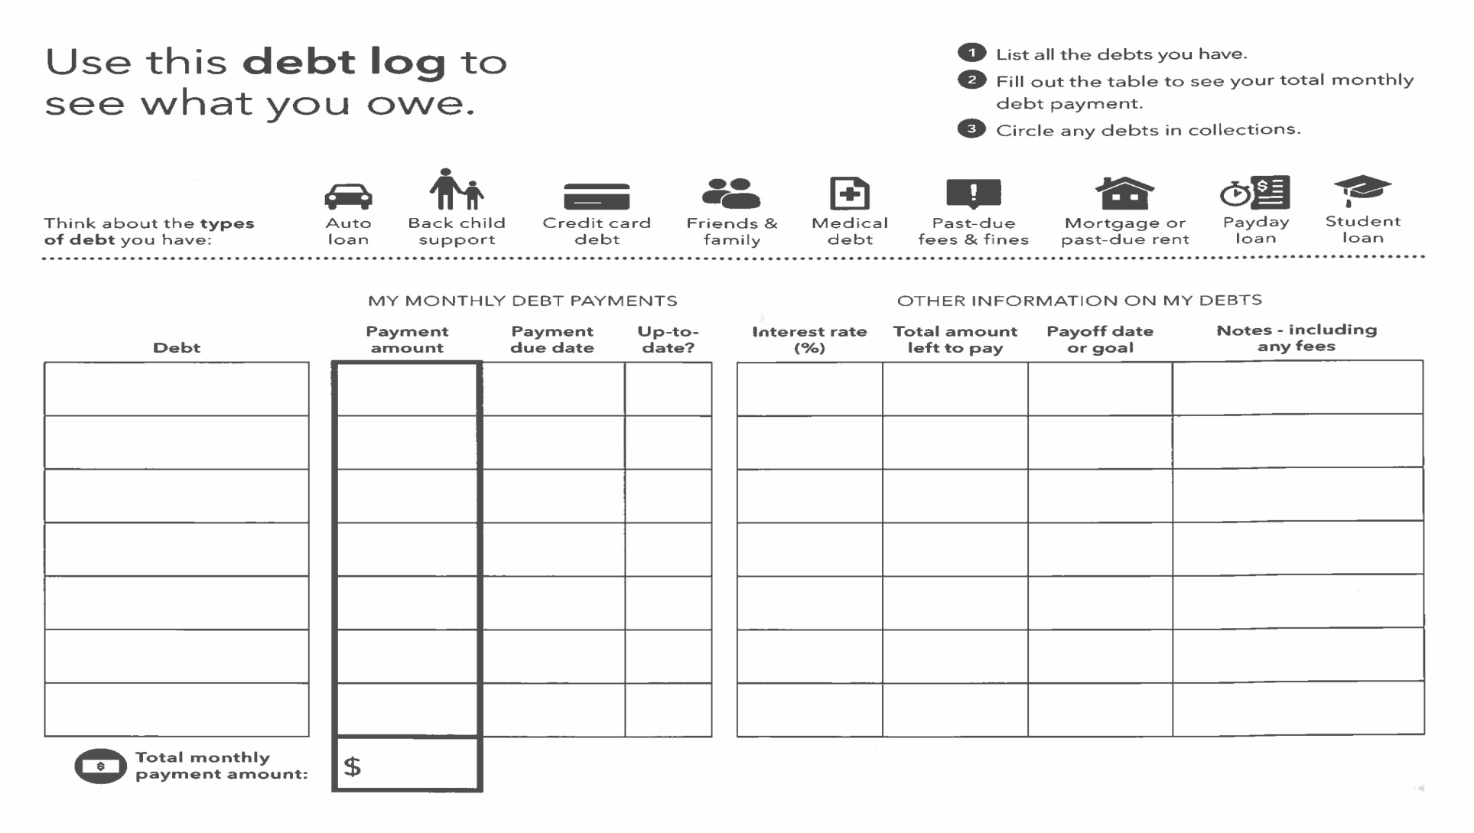
DEBT LOG

Slide 7
STEP 3 – FOCUS ON SPENDING THAT HELPS YOU MEET YOUR GOALS
LOOK AT YOUR EXPENSES
ARE THEY LEFTOVERS OF OLD HABITS
LEAVE BEHIND EXPENSES THAT DON’T LINE UP WITH YOUR GOALS
THE GOAL IS TO FOCUS YOUR SPENDING ON THE THINGS THAT ARE MOST IMPORTANT TO TAKING GOOD CARE OF YOURSELF.

Slide 8
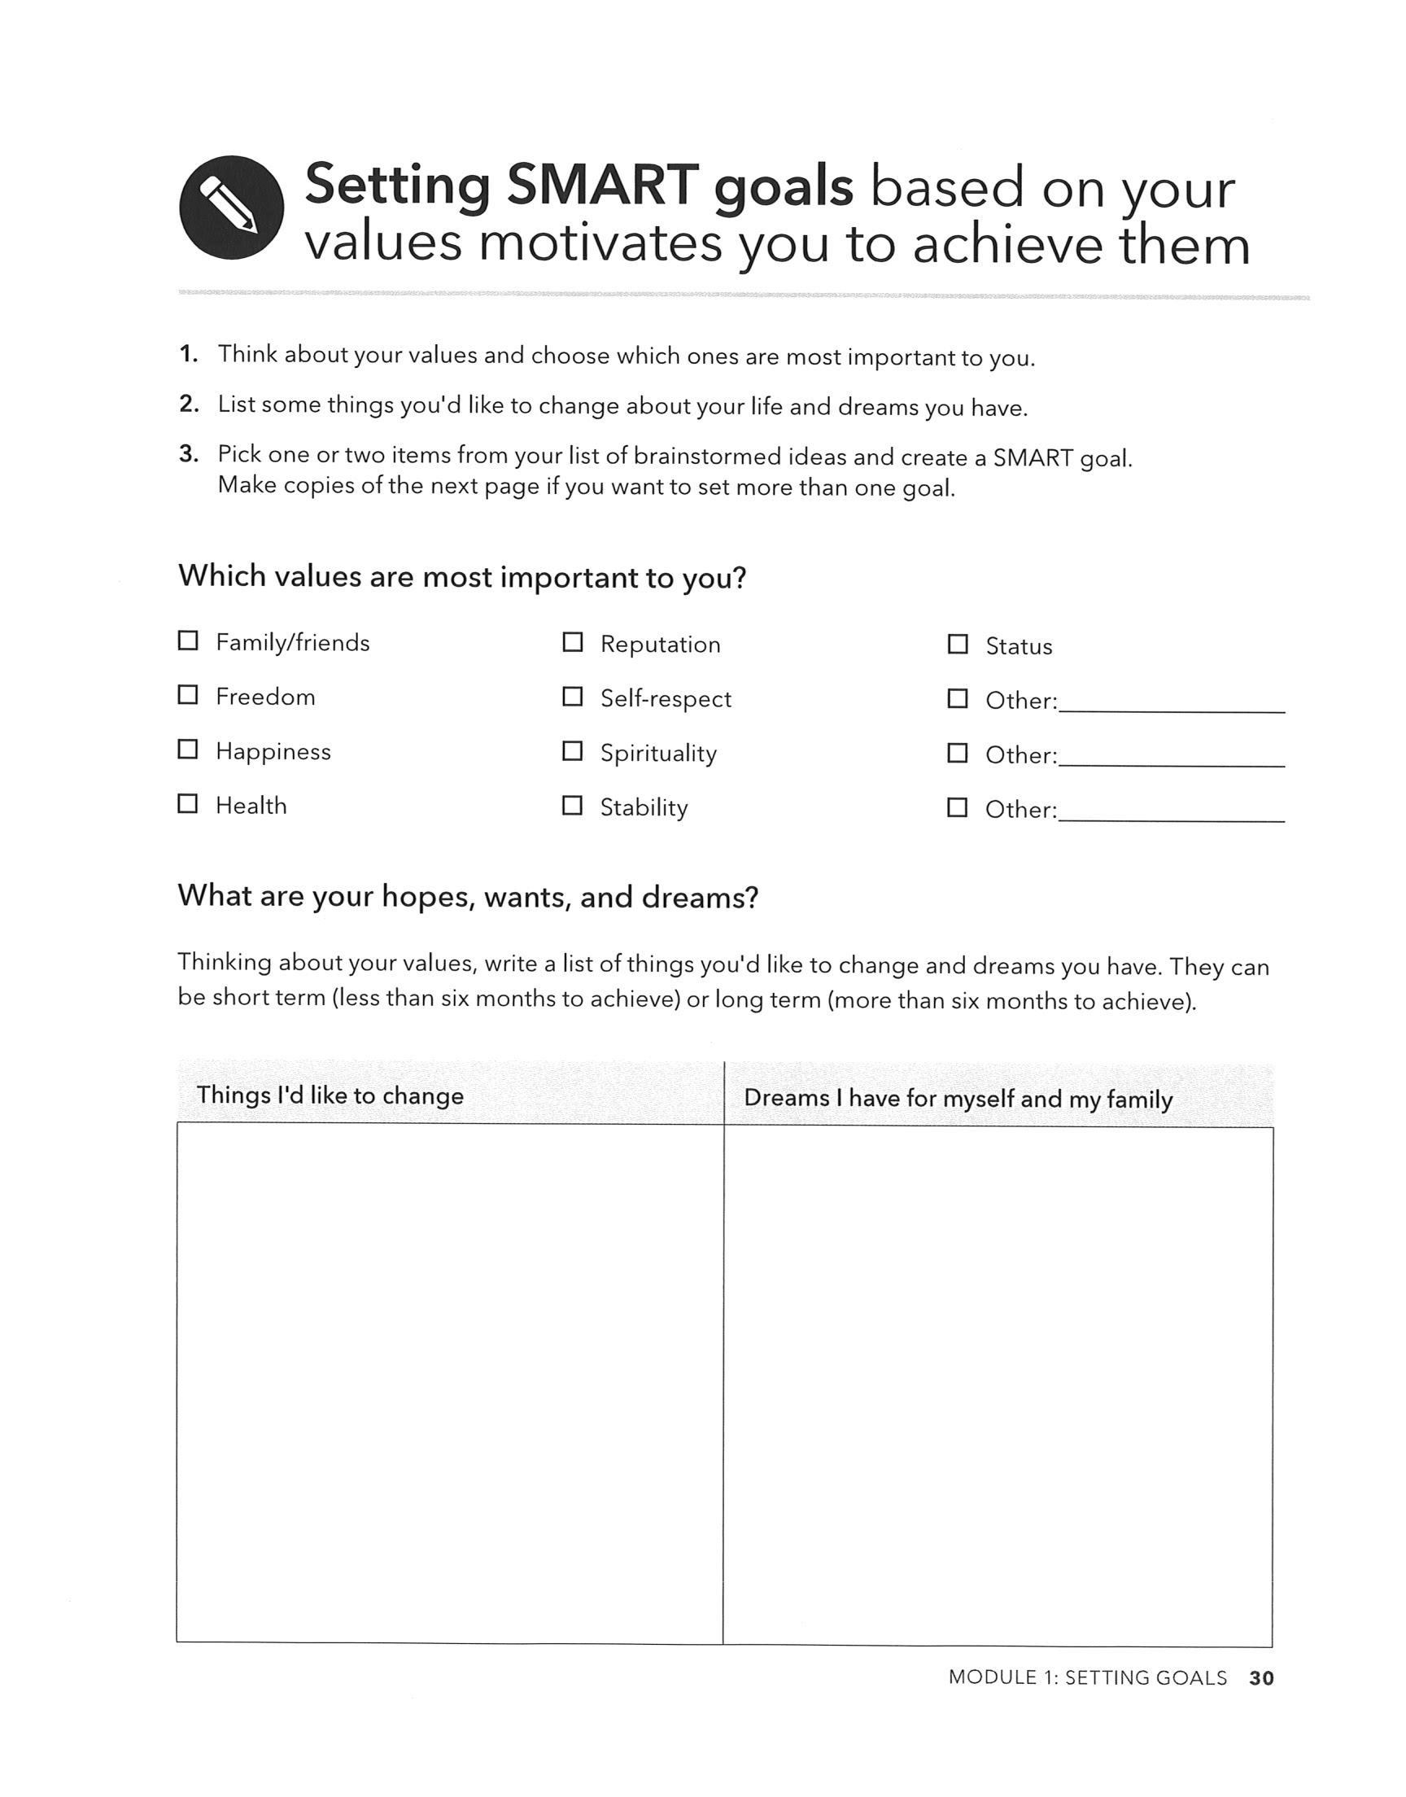

Slide 9
STEP 4 – CREATE A SPENDING PLAN
YOU DEFINED THE “WHY” BEHIND YOUR SPENDING
YOU NARROWED DOWN YOUR NECESSARY EXPENSES
NOW DEVELOP A SPENDING PLAN
A SPENDING PLAN ALLOWS YOU TO PRIORITIZE YOUR SPENDING AHEAD OF TIME BASED ON YOUR VALUES & LONG-TERM GOALS, MAKING SURE YOU HAVE THE MOST IMPORTANT ITEMS COVERED FIRST.

Slide 10
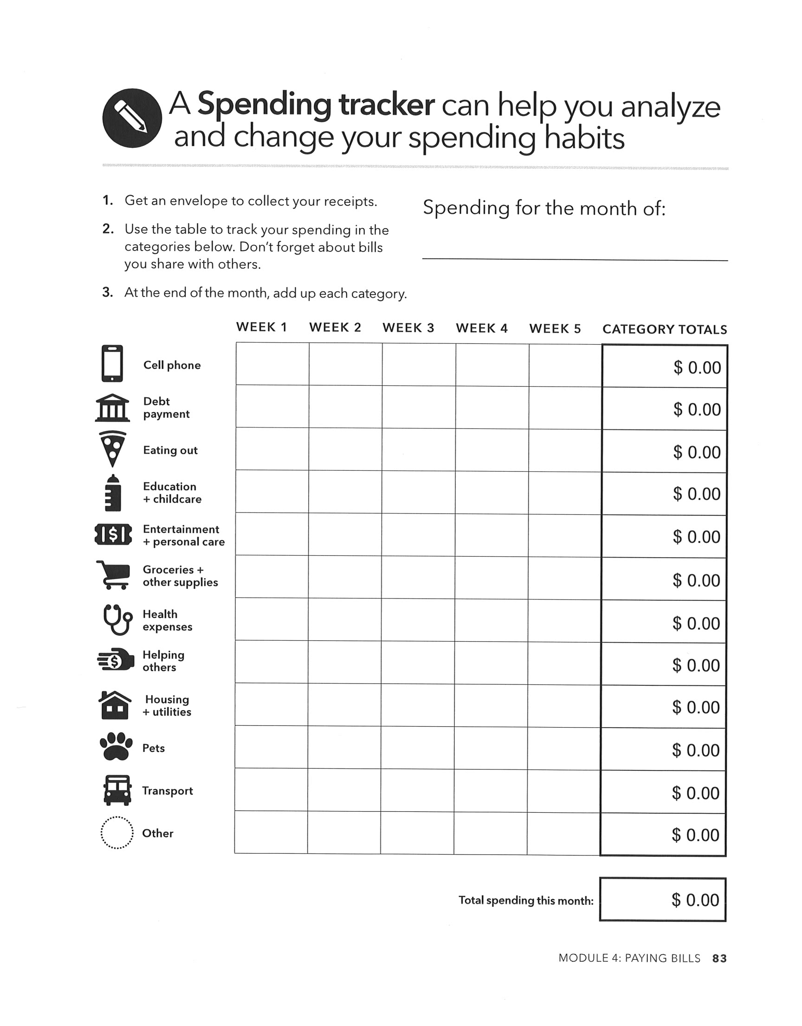
SPENDING TRACKER

Slide 11
Practicing financial self-care is an ongoing process. Make it a habit and dedicate time throughout your week to work on it. Just like exercising, the more you practice, the easier it gets!

Slide 12
Resources
GreenPath – www.greenpathref.com
Consumer Financial Protection Bureau
The Soul of Money – Lynne Twist

